Slide 1
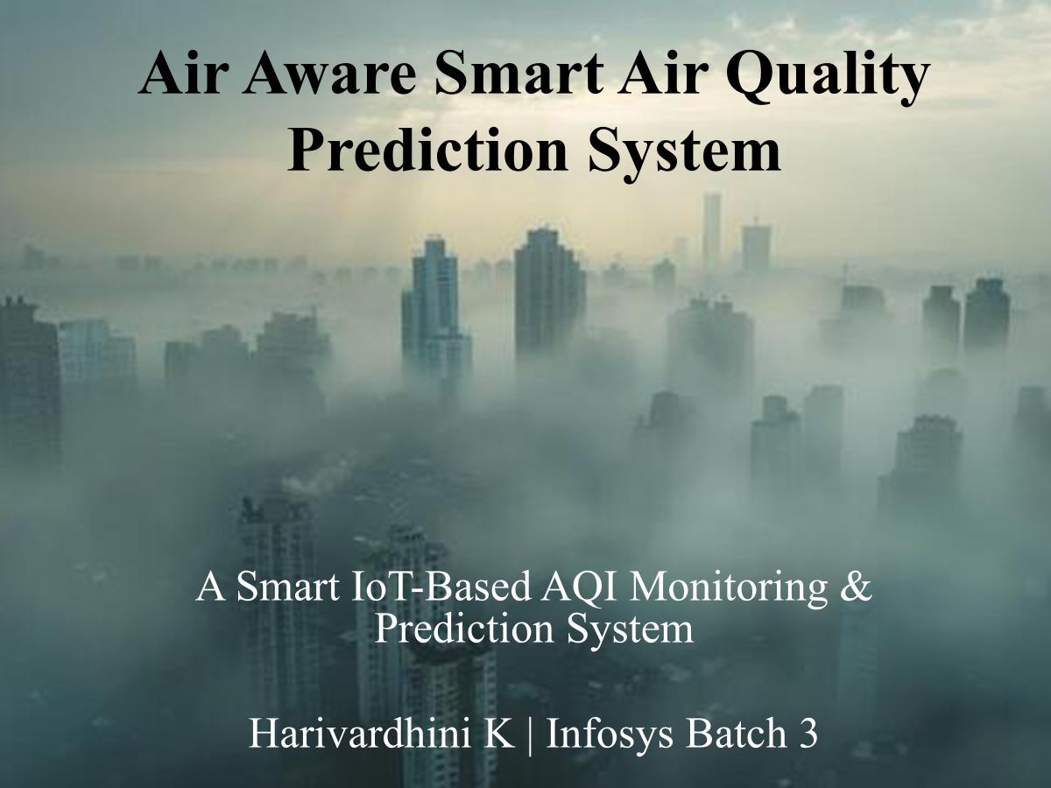

Slide 2
Project Overview
Description:
Air Aware is an AI-powered system designed to monitor and predict the Air Quality Index (AQI) using machine learning models, authenticated datasets, and an interactive analytics dashboard. The system provides real-time insights, pollutant-level analysis, and future AQI forecasting to help users understand environmental health conditions and make informed decisions.
Purpose of the Project:
To accurately predict Air Quality Index (AQI) using machine learning algorithms
To analyze major pollutants (CO, SO₂, NO₂, NH₃, Pb, PM2.5, PM10) using historical AQI datasets
To provide real-time visualization and comparative analytics through a web dashboard
To help individuals, communities, and authorities identify pollution risks early
To create a low-cost, scalable, AI-based solution for air quality monitoring without hardware dependency

Slide 3
Tech Tools & Technologies Implemented
Software & Languages
Python – ML modeling, data processing
Streamlit – Interactive web dashboard
Jupyter Notebook – Data analysis & model development
Machine Learning Tools
Scikit-learn – Regression & prediction models
Pandas, NumPy – Data cleaning, transformation
Matplotlib / Plotly – Data visualization
Datasets
Public AQI datasets (CPCB / Kaggle / OpenAQ)
Includes pollutant concentrations, weather variables & historical AQI values
Deployment
Local or cloud-hosted Streamlit dashboard

Slide 4
Understanding AQI (Air Quality Index)
Definition:
The Air Quality Index (AQI) is a standardized numerical scale that indicates the quality of air in a specific region. It communicates how polluted the air is at present or how polluted it is expected to become.
Purpose of AQI:
Helps citizens understand daily air pollution levels
Indicates health impacts associated with pollutant concentration
Assists government and environmental agencies in air quality management
Provides a unified metric for comparing pollution across cities
Key Pollutants That Affect AQI
AQI is influenced by the concentration of major pollutants released from vehicles, industries, dust sources, and burning activities.

Slide 5
The five critical pollutants affecting AQI include:
1. Carbon Monoxide (CO)
Produced by incomplete combustion (vehicles, generators)
Reduces oxygen-carrying capacity of blood
2. Sulphur Dioxide (SO₂)
Emitted from coal, oil, and industrial activities
Causes respiratory irritation and smog formation
3. Nitrogen Dioxide (NO₂)
Released from vehicle exhausts, power plants
Leads to lung inflammation and ozone formation
4. Ammonia (NH₃)
Originates from fertilizers, cleaning chemicals, waste
Causes eye and skin irritation
5. Lead (Pb)
Comes from metal smelting, old fuels, battery industries
Affects the nervous system and cognitive development

Slide 6
How to Measure AQI Factors
Measurement Methods for Key Pollutants
1. Carbon Monoxide (CO)
Measured using Non-Dispersive Infrared (NDIR) analyzers
Collects CO concentration in parts per million (ppm)
2. Sulphur Dioxide (SO₂)
Measured using UV Fluorescence analyzers
Determines SO₂ concentration in micrograms per cubic meter (µg/m³)
3. Nitrogen Dioxide (NO₂)
Measured using Chemiluminescence analyzers
Widely used by agencies for NOx (NO + NO₂) detection
4. Ammonia (NH₃)
Measured using Cavity Ring-Down Spectroscopy or Chemical absorption methods
Values recorded in µg/m³
5. Lead (Pb)
Measured using High-Volume Air Samplers (HVAS)
Filters are analyzed in labs using Atomic Absorption Spectroscopy (AAS)

Slide 7
Additional AQI Pollutants (Often Included in Datasets)
PM2.5 & PM10: Measured using Beta Attenuation Monitors and Laser Scattering
Ozone (O₃): Measured using UV Photometric analyzers
Data Used in This AI Project
Since this is a software-only AI model, pollutant data is taken from:
CPCB (Central Pollution Control Board)
OpenAQ
Kaggle AQI datasets
These datasets already include pollutant concentrations measured by certified monitoring stations.

Slide 8
AQI Monitoring Agencies & Applications
1. International Agencies
WHO (World Health Organization)
Sets global air quality guidelines and pollutant limits.
EPA (Environmental Protection Agency, USA)
Defines U.S. AQI scale; monitors PM, CO, NO₂, SO₂, O₃.
2. Indian AQI Agencies
CPCB (Central Pollution Control Board)
Maintains National AQI (NAQI) and runs CAAQMS monitoring stations.
SAFAR (System of Air Quality and Weather Forecasting and Research)
Metro-city AQI updates and short-term pollution forecasts.
SPCBs (State Pollution Control Boards)
State-level air quality monitoring and reporting.
Popular AQI Apps/Web Platforms
SAFAR-Air – Govt real-time AQI + weather
IQAir AirVisual – City-wise world AQI rankings

Slide 9
Major Contributors to Air Pollution
Air pollution is caused by multiple human-made and natural activities. While some sources receive national attention, many everyday activities significantly degrade local air quality.
Common Pollution Sources Across Indian Cities
Vehicular Emissions: Cars, trucks, buses releasing CO, NO₂, PM
Industrial Pollution: Factories, chemical plants, smelting units
Construction Activities: Dust, cement particles, PM10
Solid Fuel Combustion: Coal, firewood, and charcoal used for cooking/heating
Biomass Burning: Dry leaves, agricultural waste, garbage burning
Diesel Generators: Backup power sources releasing NOx and PM
Wood Burning: Domestic and small-scale heating
Urban Irritants: Road dust, open waste dumping, small workshops

Slide 10
Region-Specific High-Impact Sources
Brick-making industries near Delhi emit large quantities of PM10 and SO₂
Stubble burning in Punjab and Haryana contributes to severe seasonal smog
These activities often dominate national headlines due to their scale and impact.
Regulated Pollutant Categories in India
According to national air quality standards, India monitors and regulates eight key pollutants, which determine the AQI:
Ground-level Ozone (O₃)
Particulate Matter (PM10)
Particulate Matter (PM2.5)
Carbon Monoxide (CO)
Sulphur Dioxide (SO₂)
Nitrogen Dioxide (NO₂)
Ammonia (NH₃)
Lead (Pb)
These pollutants collectively define the level of air pollution in any region.

Slide 11
Impact of Air Pollution on Humans & the Earth
Harmful Effects on Human Health
Short-Term Health Effects
Coughing, throat irritation, burning eyes
Breathing discomfort, wheezing, shortness of breath
Headaches and dizziness
Allergic reactions and increased asthma symptoms
Long-Term Health Effects
Chronic bronchitis and asthma
Reduced lung function and lung cancer
Cardiovascular diseases
Premature aging of lungs and long-term tissue damage
Negative developmental effects in children
Increased risk of stroke, heart attacks, and early mortality

Slide 12
Harmful Effects on the Earth & Environment
Climate & Atmospheric Impact
Global Warming: Pollutants trap heat and increase Earth’s temperature
Ozone Layer Damage: Certain gases contribute to ozone depletion
Smog Formation: Reduces visibility and worsens city air quality
Environmental & Ecological Damage
Acid Rain: Causes soil acidification and affects water bodies
Crop Damage: Ozone and particulate matter reduce agricultural yield
Soil Degradation: Chemical deposits alter soil nutrients
Water Pollution: Pollutants settle into rivers and lakes
Ecosystem Imbalance
Harm to birds, animals, insects, and aquatic life
Disruption in natural food chains
Reduced biodiversity in forests and urban green zones

Slide 13
Solutions to Reduce Air Pollution
Technological Solutions
Air Purifiers
Remove particulate matter (PM2.5, PM10) and harmful gases
Useful for homes, hospitals, offices, and polluted urban areas
2.Emission Control Technologies
Catalytic converters for vehicles
Industrial scrubbers to reduce SO₂ and NOx emissions
3. Electric Vehicles (EVs)
Reduce reliance on fossil fuels
Lower CO, NO₂, and particulate emissions
Renewable Energy Adoption
Transition to solar, wind, and hydro reduces combustion pollutants

Slide 14
Urban & Environmental Solutions
Greenery & Plantation Drives
Trees absorb CO₂, SO₂, and PM
Improves oxygen levels and reduces heat islands
Dust Control Measures
Water sprinkling, covering construction sites
Reduces PM10 and PM2.5 spread in urban areas
Waste Management
Reducing open garbage burning
Promoting recycling and safe disposal
Governmental & Policy-Based Solutions
Implementation of stricter pollution standards
Odd-even vehicle schemes, traffic restrictions
Banning of high-emission fuels and outdated vehicles
Promotion of public transport and carpooling

Slide 15
Impact of the Project on Earth, Humanity & the World
🌍 Overall Impact
Your AI-powered Air Quality Prediction and Awareness System creates tangible environmental and societal benefits:
Promotes cleaner ecosystems by helping citizens understand pollution patterns and take preventive actions.
Supports government/environmental planning with early warnings and predictive insights.
👥 Impact on Humanity
Helps people avoid respiratory issues, asthma triggers, and long-term illnesses.
Empowers communities to demand better local environmental policies.
🌐 Global Impact
Aligns with UN Sustainable Development Goals (SDG 3 – Good Health & Well-being, SDG 11 – Sustainable Cities).

Slide 16
🧠 Coding Details (Tech Stack Used)
This is pure AI + software, no hardware involved.
Technologies Used:
Python – core programming language
Streamlit – for interactive dashboard
Machine Learning Algorithms – Linear Regression / Random Forest for AQI prediction
Pandas, NumPy – data cleaning & processing
Plotly / Matplotlib – visualization and charts
Scikit-Learn – model training and testing
VS Code / PyCharm – coding environment
Dataset – Open-source air quality datasets (e.g., CPCB, Kaggle AQI data)

Slide 17
How the Project Solves the Problem
✅ 1. Predicts Air Quality Before It Becomes Harmful
Your AI model analyzes historical pollutant data and predicts AQI levels, giving early warnings so people can avoid exposure.
✅ 2. Makes Pollution Data Understandable for Everyone
Through your Streamlit dashboard, users can:
View AQI in simple colors & charts
Track trends for PM2.5, PM10, NO₂, CO, SO₂, NH₃
✅ 3. Helps People Take Preventive Actions
With alerts and predictions, users can:
Avoid outdoor activities during high AQI
✅ 4. Supports Organizations & Agencies
Authorities and NGOs can use prediction data to:
Plan traffic & industrial operations
Implement pollution control measures
✅ 5. Contributes to Environmental Sustainability
By enabling awareness, your system drives:
Cleaner habits
It becomes a small but significant step toward a greener planet.

Slide 18
🌟 Future Enhancements
🔹 1. Real-Time API Integration
🔹 2. Deep Learning-Based Prediction
🔹 3. Location-Based Personalized Alerts
🔹 4. Health Impact Suggestions
🔹 5. Historical Data Comparison
🔹 6. Anomaly Detection
🔹 7. Predictive “What-If” Analysis
🔹 8. Integration with Satellite Air Quality Data

Slide 19
Steps to Run the Project
1. Clone the Project Repository
Download or clone the GitHub repo:
Air_Aware_SmartAirQuality_PredictionSystem_infosys_Batch_3
Extract the folder to your local system.
2. Install Required Software
Make sure the following are installed:
Python 3.10+
Pip / Virtual Environment
Streamlit
Jupyter Notebook (optional)
Install required libraries using:
pip install -r requirements.txt
3. Set Up the Virtual Environment (Recommended)
python -m venv venv
venv\Scripts\activate (for Windows)
This keeps dependencies clean and project-specific.
4. Prepare the Dataset
Ensure the dataset CSV files are placed in the specified data/ directory.
The model uses pollutant features like PM2.5, PM10, NO₂, SO₂, CO, NH₃ for AQI prediction.
No hardware sensors are required — it is fully AI-based.

Slide 20
5. Run the Model Training (Only if Needed)
If you want to retrain:
python model_training.py
This generates:
Trained ML model (RandomForest/Regressor, etc.)
Saved .pkl model file for prediction.
6. Launch the Streamlit Dashboard
Run the application:
streamlit run M4_Main_Dashboard.py
This opens the interactive dashboard with:
Live AQI predictions
Visual charts
Pollutant trends
AQI category insights

Slide 21
7. View Results
Once the dashboard opens:
Select the city or dataset
View real-time/forecasted AQI
Explore pollutant-level visualizations
8. Modify or Extend the Project (Optional)
You can:
Edit model accuracy configuration
Change pollutant features
Integrate real-time API sources
Add new visualizations or UI elements
9. Deployment (Optional)
Deploy using:
Streamlit Cloud
Heroku
Render
AWS / Azure

Slide 22
THANK YOU!!!

